Slide 1
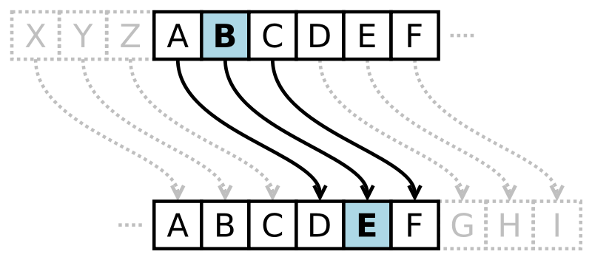
Id: 222902036
Name: Md. Sohan Millat Sakib
Simple Encryption
Title of the project :
Caesar cipher: Data Encryption by a key.
Introduction :
Caesar cipher is a simple method of encoding messages. Caesar ciphers use a substitution method where letters in the alphabet are shifted by some fixed number of spaces to yield an encoding alphabet.
It is a type of substitution cipher in which each letter in the plaintext is replaced by a letter some fixed number of positions down the alphabet. For example, with a left shift of 3, D would be replaced by A, E would become B, and so on.

Slide 2
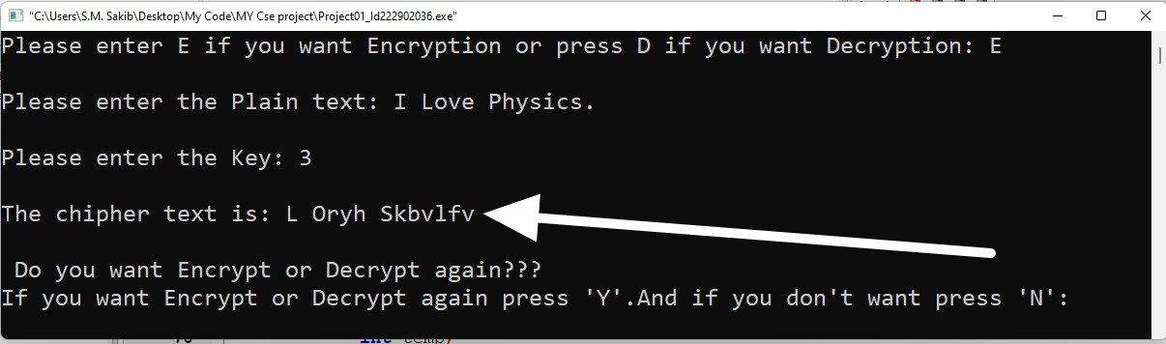
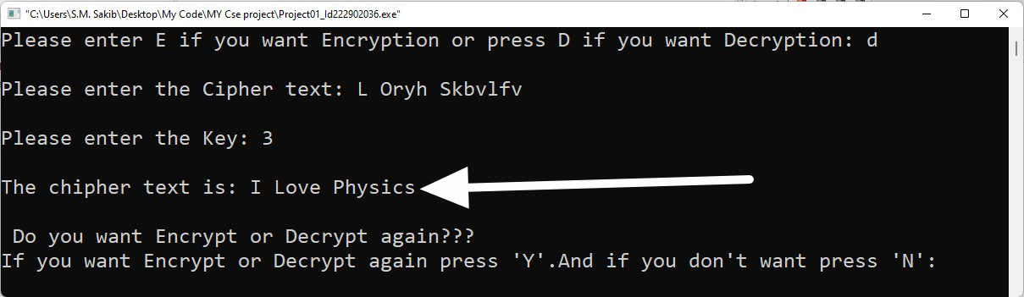
Method of the project :
Caesar Cipher is one kind of encryption method. I write a program which is working for this encryption and decryption. At first the program want to know what i want to do either encrypt of decrypt. If user press ‘E’ then the program decide to
Encryeption. Else if user press ‘D’ the programme decide to decrypt data. For Encryption the program take a plain text and a key to encrypt data and finally the program encrypt the data. And for decryption user input the cipher text and user have to know the key and enter the key..Then the programme decrypt message. The sketch of Ceaser Cipher Encryption and Decryption bellow.
Encryption
Decryption

Slide 3
Socio economic importance :
We need to security to sent any message in different time for different kind of reason. If we want to sent a message anyone we can sent message secetely. When I sent any pure data through internet hacker can read easily the message. But if we encrypt the message the hacker can’t read the message easily. So Encryption methode is very important for secure our information.
.
Time for making the project:
Start date : 21-11-2022, I start the work for the project.And within two day’s I completed my project.
Conclusion :
There have many kind of Encryption method … But the Ceaser cipher method is bulid up with most easy algorithm..
Reference:
https://en.wikipedia.org/wiki/Caesar_cipher https://www.geeksforgeeks.org/caesar-cipher-in-cry ptography/
https://www.dcode.fr/caesar-cipher

